Slide 1
Ames, Iowa Home Variables Exploratory Data Analysis
Evan Hildreth

Slide 2

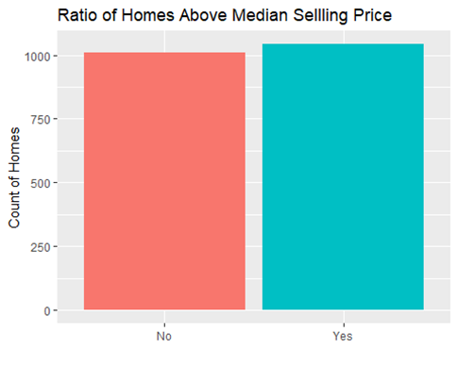
Introduction
The purpose of this phase of our analysis is to conduct an exploratory analysis of the homes sold in Ames, Iowa so that we may find the strong variables for future data analysis.
Specifically, to find what characteristics may help us to predict if a home sold in Ames was sold for above the median home value at time of sale.
Our dataset looked at 2053 homes and each has 80 variables.
As we can see to our left, there are slightly more homes above median than bellow.

Slide 3
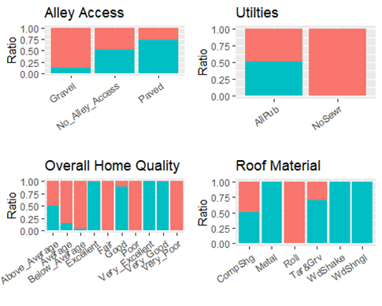

Qualitative Variables
For our first set, we will be exploring the most significant qualitative variables in their relationship between them and how often did homes with these values sell for above median home value (blue) or under (red).
If a bar is completely blue, it means that all homes with that value sold for above median home value (and vice versa).
This dataset contains 47 Qualitative Variables. The following is the 13 most interesting and/or significant

Slide 4
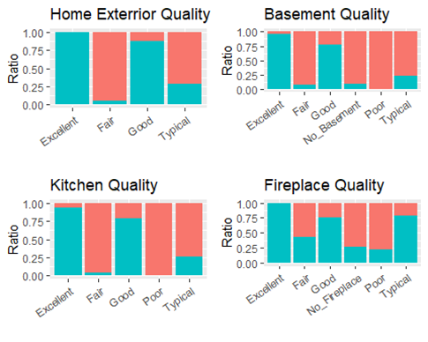
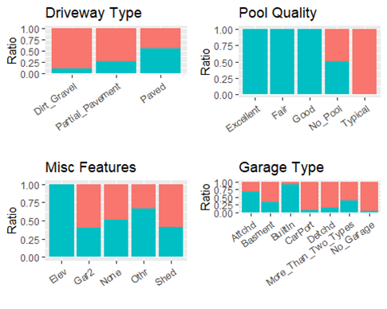
Qualitative Values Continued

Slide 5
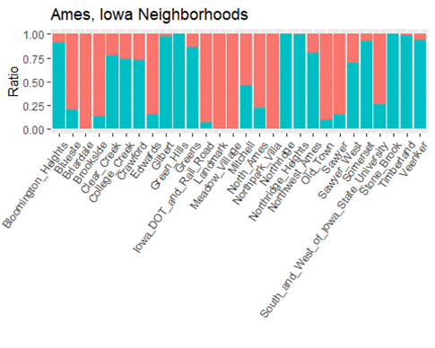
Qualitative Variables Wrap Up
After running analysis on the 47 qualitative variables, we have narrowed down to 13 significant variables. To summarize what we found:
Strong Excellent and Good quality markers for almost every variable (Overall Home, Exterior, Basement, Kitchen, Fireplace, and Pool) almost always lead to above median homes (and vice versa).
Paved alleys and driveways are preferable to non paved and partially paved but it does not guarantee.
Garage type and roof materials also play a major roll.
If the home is not hooked up to sewer it is basically guaranteed to sell bellow median, but the reverse is not true.
Lastly, what neighborhood the home is in, as seen to the right, makes a major impact as some neighborhoods are almost guaranteed to sell above median while the opposite for others.

Slide 6
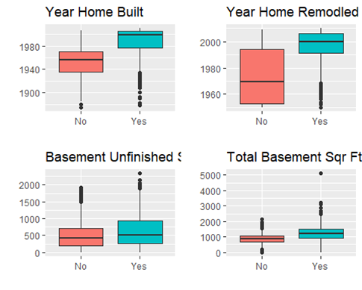
Quantitative Variables
Next, we will be exploring the Quantitative variables and their relationship to being sold at above or bellow median home value (yes/no).
For the Quantitative set we have 31 variables to work with and 7 were found to hold major significance and/or interesting.
Note: As seen on next slide, “Total Bathrooms” is a “Created Variable” we created by adding up all bathrooms for each home entry.

Slide 7
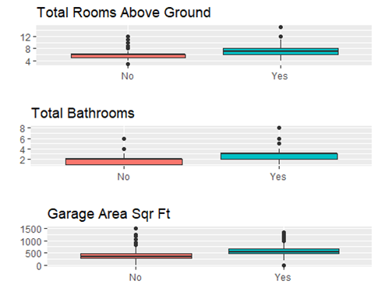
Quantitative Variables Wrap Up
After running analysis on the 31 quantitative variables, we have narrowed them down to 7 significant variables. To summarize what we found:
The year that a home was built, or remodel holds major significance to said home being sold for above median or not with the more recent years generally being more likely to be ‘yes’ than ‘no’
Having more square feet, of any kind or for any room tends to increase chances of being sold for above median.
Lastly, having more bathrooms, or more rooms in general, tended to be associated with homes sold above median home prices in Ames, Iowa.

